Slide 1
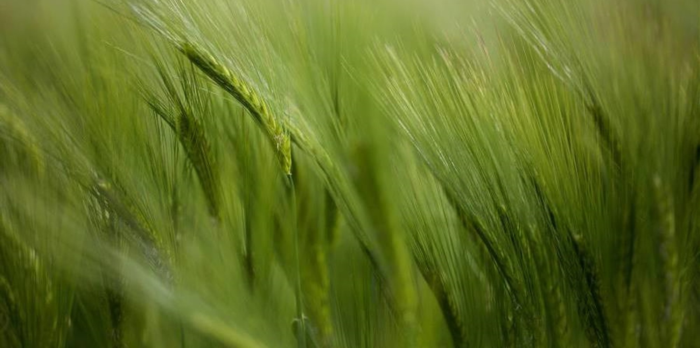
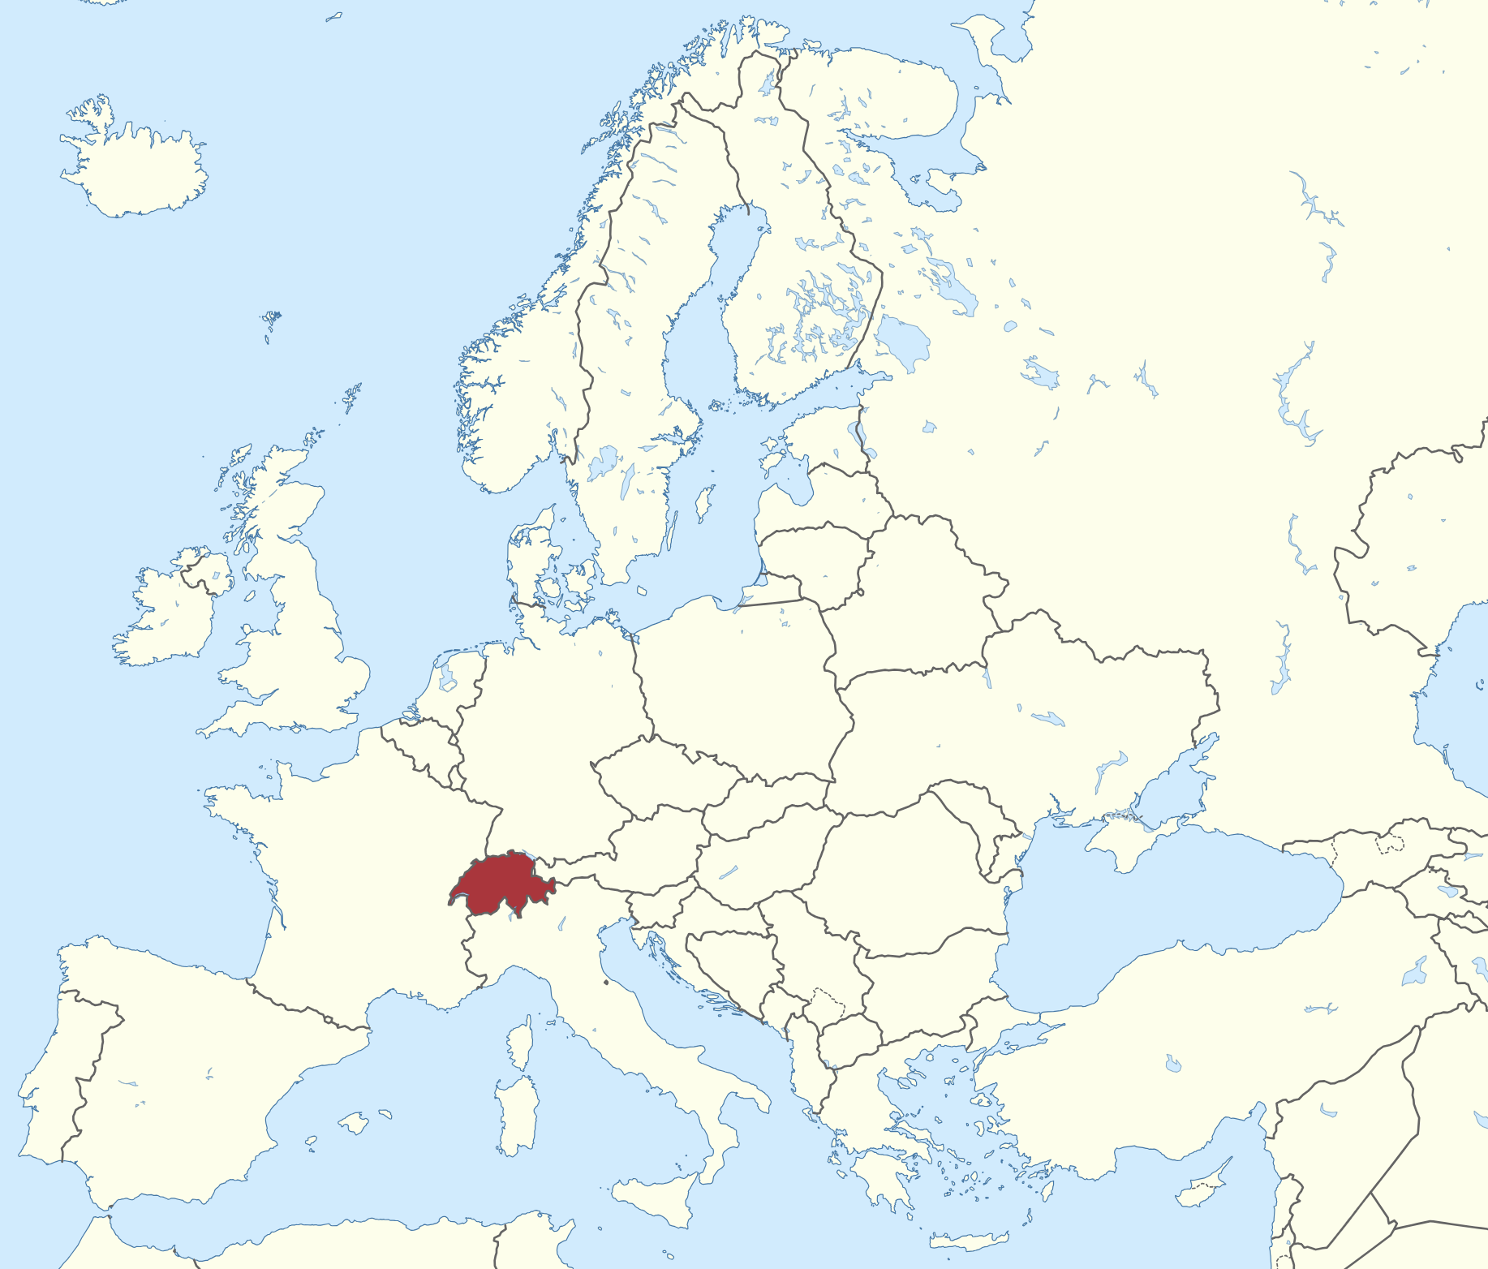
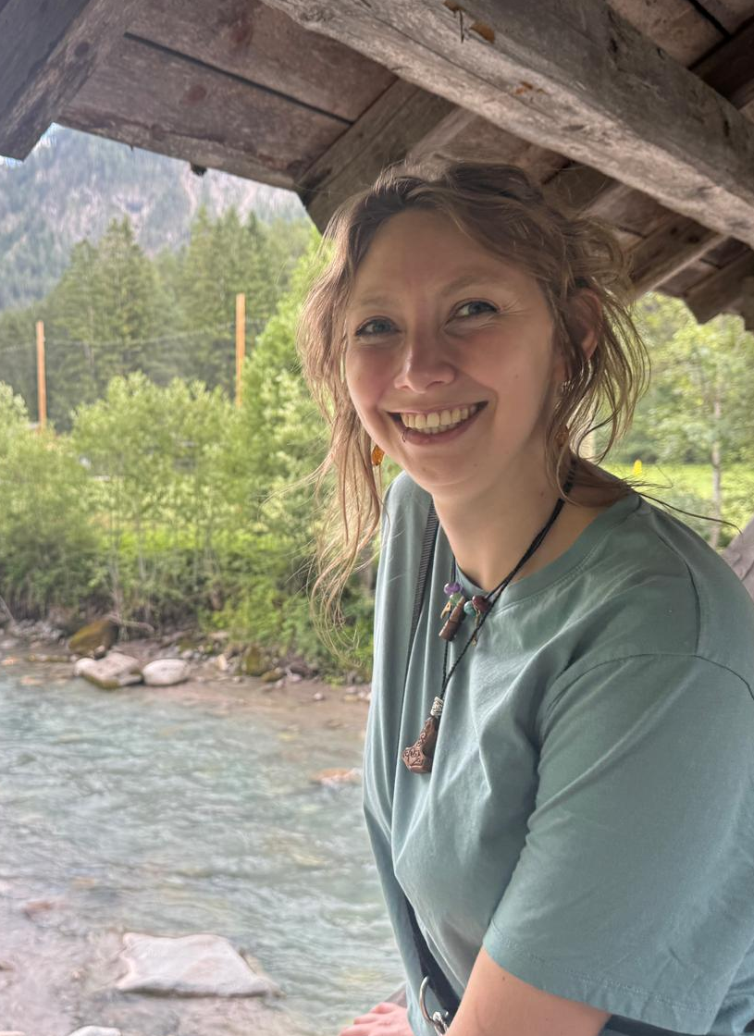
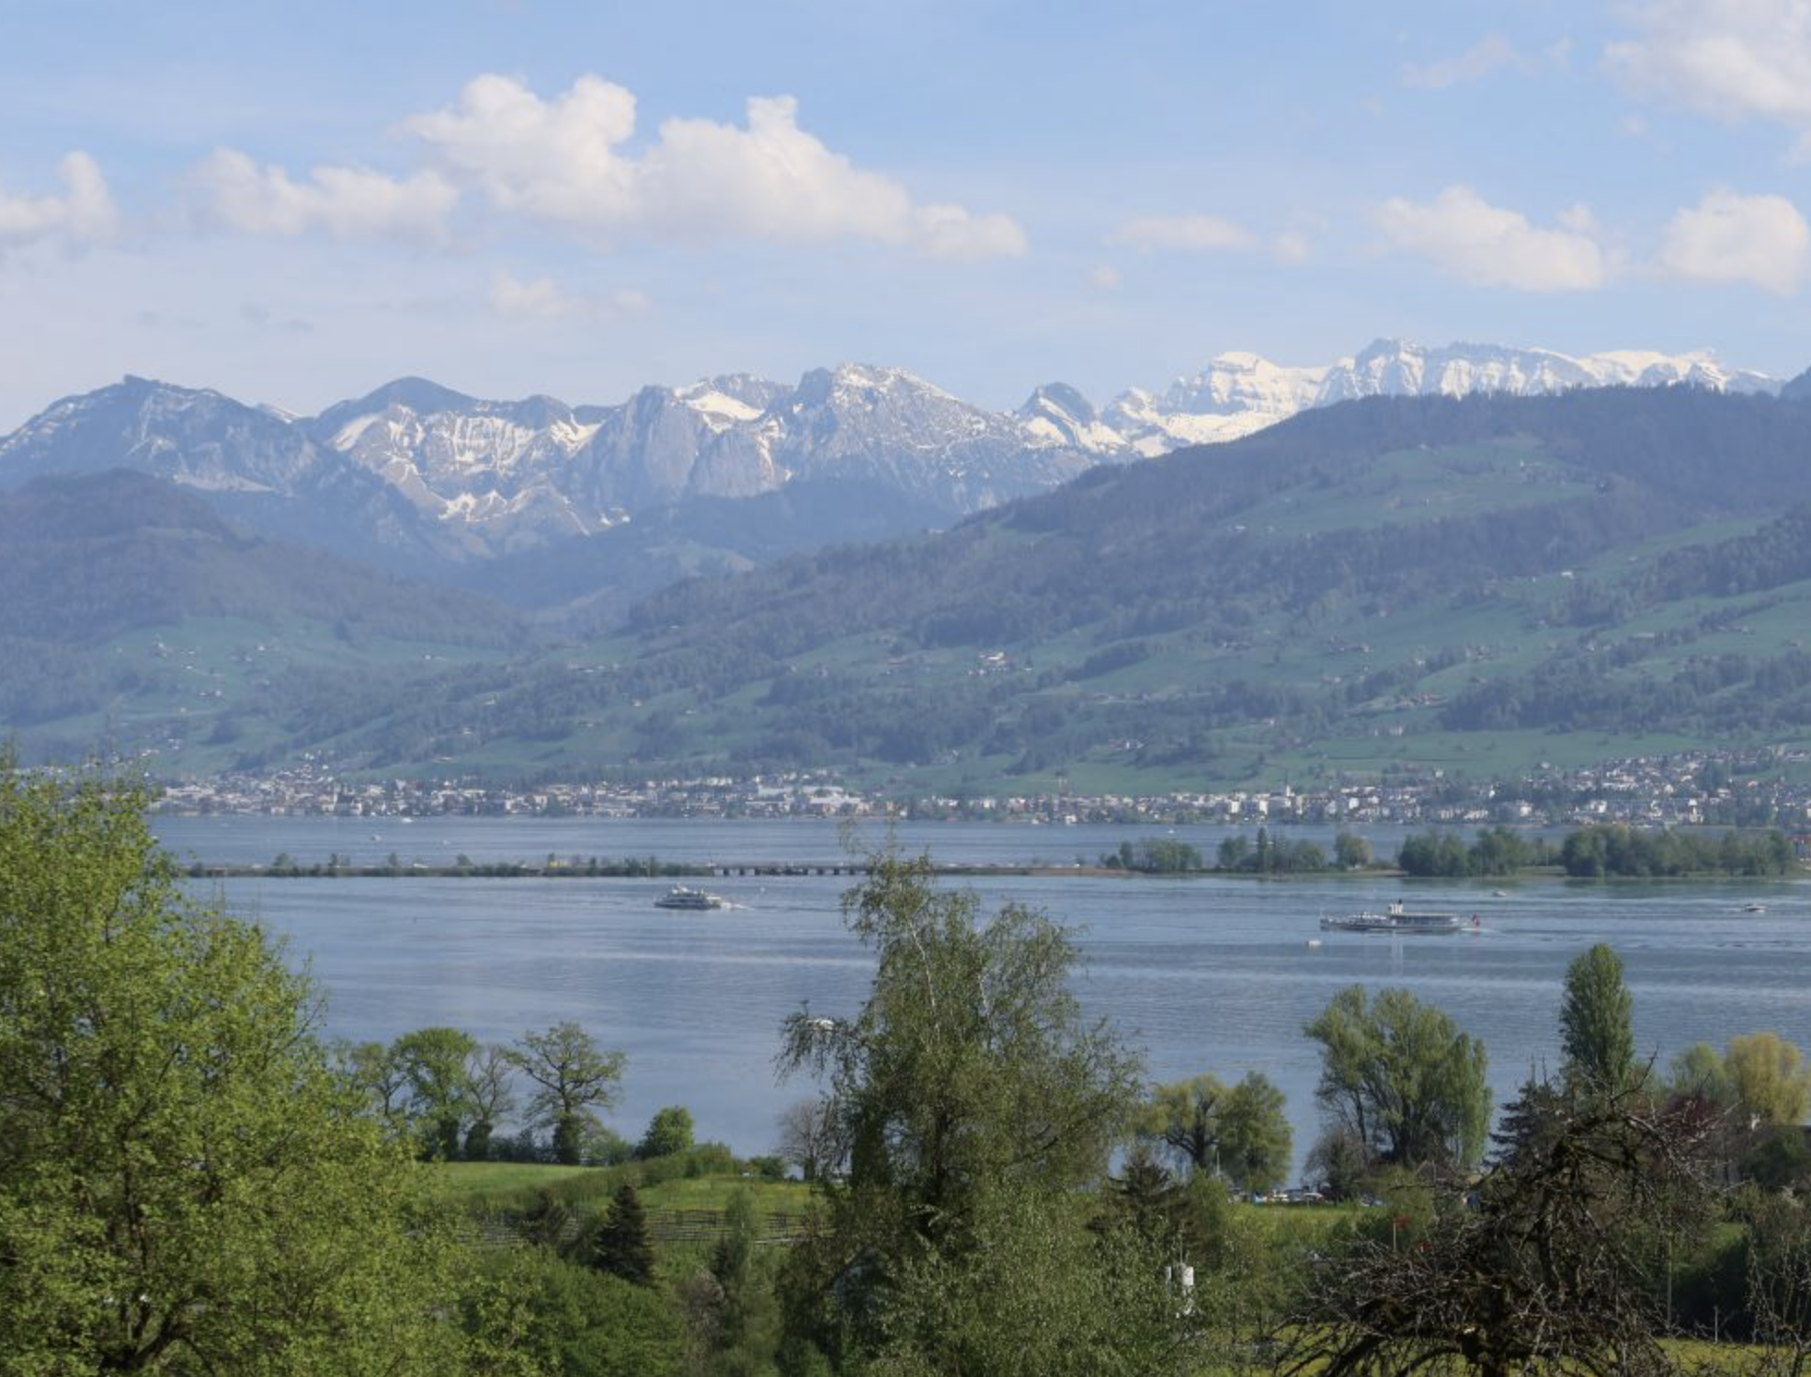




Sandra Nina Stern
University: Eastern Switzerland University of Applied Sciences (OST)
Study program: Landscape architecture
Year of study: 2nd year, parttime
City: Zürich, Switzerland
Motto for life: There’s always a fire exit
Hobbies: Adventures with my dog, playing videogames, hoarding plants, historical reenactment, trying new hobbies
Your expectations from the summer school: Meet new people and their views/inspirations, become more hopeful about the future
where I live, work and study
Karlsruhe
31 August to 11 September 2026

